Slide 1
Ecclesiastical Overview How Can We Help
Heather Ford
Church Support Manager
Blackburn Diocese Church Warden Training
July 2023

Slide 2
Ecclesiastical Insurance - Benefact Group
Over 130 years insuring churches
Leading UK insurer of churches and heritage buildings
Part of the Benefact Group
Owned by a charitable trust – Benefact Trust
Specialist Church team
Helping your church to thrive
Notes:
135 + years of supporting churches. 1000 + years of experience – we understand churches, buildings and structure of CofE. Above that passion for churches
We are owned by a Charity – Benefact Trust (All Churches Trust). All available profits from the group go to BT to distribute as grants to churches and charities.
Major rebrand in March – EIG became Benefact Group. Add clarity – customers and partners didn’t appreciate that Ecclesiastical was and remains part of a larger group of financial services – specialist businesses (all of which contribute to the profits of the Group)
The rebranding was an opportunity to explain this better – demonstrate that there is a wider network of companies contributing to the Group and in turn generating income for the Benefact Trust
At Ecclesiastical we have a wealth of experts, whose exereince churches can draw upon and tonight I am joined by Huw Andrewes - Principle Casualty Consultant. Huw has provided much of the written guidance on our website ( a document will be circulated signposting to these resources. These resources are there to help you navigate the H&S landscape and to provide information you need to help you fulfil your H&S obligations.
Its worth noting that alongside our in house expertise – we work closely within the H&S industry. Huw in particular works closely with the HSE to ensure our resources are up to date and relevant and so that should provide you with additional comfort that the information on our website is up to date and based on expert knowledge.

Slide 3
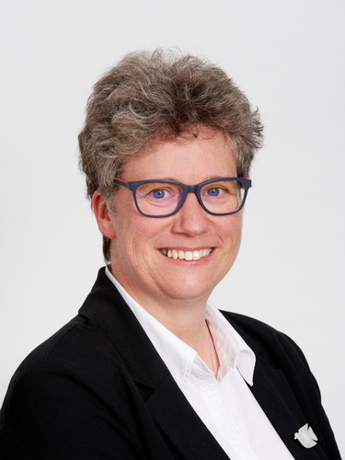
Heather Ford - Church Insurance Consultant
Started with Ecclesiastical – January 2020
Church Buildings Officer for 7 years with Manchester Diocese
Housing Association Development Manager for 15 years – project managing large residential capital projects
Centred on ;
Built environment & Community development
Enabling parishes to do God’s work
Notes:
Delighted to be with you this evening.
I am the Church Insurance Consultant with Ecclesiastical and my role is to be the local face of the company to provide face to face support for our church customers on things like risk management, health and safety and fundraising to help them deliver their mission.
This includes visiting parishes on site, attending PCC meeting but also delivering training - as I am doing this evening. This session is just the start – there will be Q&A at the end but you can always come back to me if you think of things later.
My background has focused on the built environment – prior to joining Ecclesiastical just before the first lockdown – ( an interesting time to start a new job ! ) I had the privilege of being the CBO with Manchester diocese for 7 years – so helping churches think about how they used their buildings, including providing guidance on building and reordering projects
Prior to that Development manager for 15 years – project managed multi ££ new build and refurb projects.
H&S has been a prominent feature throughout these roles.

Slide 4
Examples of how we can help
Delivering seminars or workshops tailored for churches and based on our 135 years’ experience.
We have produced guidance and can deliver training specifically for our church customers on a range of topics.
Security
&
Theft of Metal
Health and safety
Risk management
&
Fire Risk Management
Understanding Your Church Insurance Policy
Fundraising
We offer practical help and a friendly listening ear.
We have worked with, and continue to work with Dioceses to develop training and information on a variety of topics to support churches.
We can use digital platforms for meetings and training events if preferred.
These are just some of the topics covered.

Slide 5
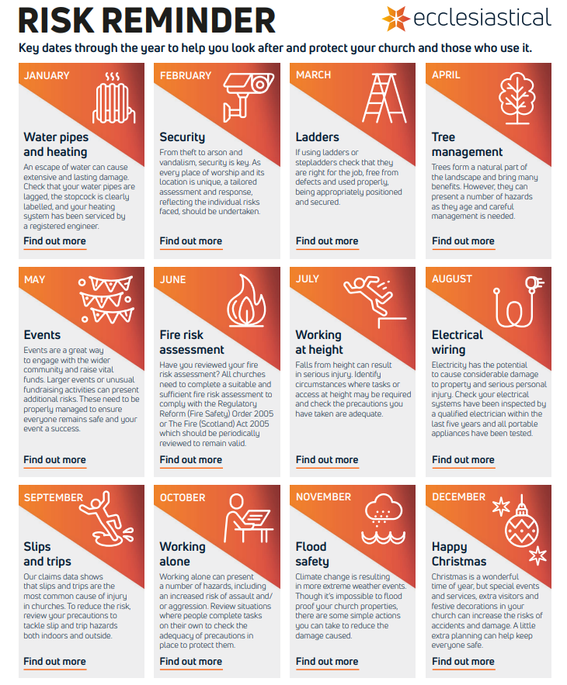
Download our risk calendar
The risk calendar marks key risks throughout the year to help you protect your church and those who use it.
It has:
Monthly hints and tips for considering the operational risks at your church.
Different topics featured throughout the year and included in the e-News we send to parish contacts.
Website page links to the relevant guidance for each topic.
You can sign up to receive our monthly e-news containing helpful guidance and information.
Notes:
Looking after your church building can often feel like a huge responsibility but by breaking tasks down into smaller monthly activities it makes things a little less daunting. This online resource helps you do this.

Slide 6
Testing to protect your church
It is important that the following items are maintained or tested on a regular basis to ensure your church is best protected.
Item | Frequency | Helpful guidance
Electrical Installation | 5 years | https://www.ecclesiastical.com/risk-management/church-electrical-wiring/
Lightning Conductor | 4 years | https://www.ecclesiastical.com/risk-management/church-lightning-advice/
Smartwater | 5 years | https://www.ecclesiastical.com/risk-management/smartwater/
Alarm Systems | Annually | https://www.ecclesiastical.com/documents/church-security-alarms.pdf
Fire extinguishers | Annually | https://www.ecclesiastical.com/documents/church-firefighting-equipment-guidance.pdf
Fixed heating systems | Annually | https://www.ecclesiastical.com/risk-management/church-heating-systems/
Any electrical installation checks and works must only be undertaken by an electrician/electrical engineer.
Work must be carried out by a qualified electrician with full scope registration or membership to work on commercial installations and certified with the National Inspection Council for Electrical Installation Contracting (NICEIC), The Electrical Contractors Association (ECA), The National Association of Professional Inspectors and Testers (NAPIT) or The Electrical Contractors’ Association of Scotland (SELECT).
There is no statutory frequency for inspection and testing of portable appliances.
Find the full guidance on our website: www.ecclesiastical.com/risk-management

Slide 7
Fundraising support for your church
We have developed a range of resources to help with funding; making the journey simpler and more successful.
Fundraising hub: Online webpages packed with guidance, checklists and video webinars.
Fundraising helpline: A dedicated fundraising helpline to talk to your local Church Insurance Consultant. Call the helpline on 0345 601 995 or request a call back on our website.
Fundraising in a box: A printed toolkit for church customers, providing step-by-step guides with the fundamentals of fundraising.

Slide 8
Things to inform us
Insured Title – please ensure the Insured title on the Policy is correct
Change of Correspondent - https://www.ecclesiastical.com/church/administering/
Building Works – Please inform us at the earliest opportunity https://www.ecclesiastical.com/risk-management/church-building-works/
Events – Large or unusual events please contact our underwriters on 0345 777 3322
If your Church is unoccupied
Claims - Please insure that all incidents (if claiming or not) are reported to our claims department on 0345 603 8381 or email churchclaims@ecclesiastical.com
General policy cover enquires – Please contact our dedicated Church team on 0345 777 3322 or email churches@ecclesiastical.com
If you would like to find out more please email the team at meetus@ecclesiastical.com

Slide 9
Contacts ;
General policy cover enquires 0345 777 3322 / email churches@ecclesiastical.com
Heather Ford Church Support Manager; heather.ford@ecclesiastical.com / 07765 246720
Risk Management Advice Line ; risk.advice@ecclesiastical.com / 0345 600 7531
Claims ;
claims@ecclesiastical.com 0345 603 8381

Slide 10
Questions?

